Slide 1


LAMBDA FUNCTIONS AND DYNAMIC ARRAYS

Slide 2
Agenda
The Why
Cell Reference Hell
Lambda Libraries
GitHub
ChatGPT
Business Use Cases
The How
Functional Fundamentals
Comparing Dependency Patterns
List and Tuples are missing

Slide 3
The Why

Slide 4




Uses of Excel
Data Processes
Results Illustration
Logic Explanation

Slide 5
Business Use Case
Third party does illustration for agents.
We throw a spreadsheet over the wall to display logic of new products.
Spreadsheet has grown in complexity over the years to accommodate all new product ideas.
People complain at lead time required to get third party to implement illustration.
Problem: Logic is convoluted and scattered throughout a large spreadsheet.
Regardless if third party or not, it will take them a long time to find changes and parse logic!
Solution: Find a way to make the logic transparent to the users downstream.
This should reduce the lead time required and improve accuracy of the implementation.

Slide 6
Eliminating Cell Reference Hell
Withdrawal Penalty - Classic
=IF($C9 <> 0,IF($F9, 1 - MAX(0, $C9 - $P8) / ($D8 - $P8), 1 - $C9 / $D9), 1)
Cell References scattered through logic, which is source of the problem.
Avoid dual concerns if possible!
Withdrawal Penalty - Map
=MAP( $D8 , $P8 , $C9 ,$D9, $F9 , $P9,
LAMBDA(prevCV, prevMAWA, WdTaken, Cv, isActivated, mawa,
LET(noWd, 1,
IF(WdTaken <> 0,
IF(isActivated,
1 - MAX(0, WdTaken - prevMAWA) / (prevCV - prevMAWA),
1 - WdTaken / Cv),
noWd))
)
)
Mapping a cell references to Lambda parameters.
All logic is separated from cell references, so moving the right direction.
Better, but still has problem of not understanding the logic between columns.

Slide 7

Wringing Out Logic into Lambda Libraries

Slide 8
Smart Lambda Libraries Make Dumb Spreadsheets!
Pay Period =SEQUENCE(Periods,,0,1/2)
Purchase Payments = 100000
Withdrawal Taken = 0
Assumed Contract Value = 100000
Is Anniversary =VA.IsAnniversary(A9#)
Is Activated =VA.IsActivated(A9#,ActivationPeriod)
INCOME BASE =DROP(
Utils.MulitSCAN({$C$9, $C$9, $C$9,0},
HSTACK($A9#,$C9#, $D$9#, $E9#, $F9#, $B9#,SEQUENCE(Periods,,MawRate,0)),
VA.MawStack)
,0,1)
Protected Income Payment =MAP($D$9#,CHOOSECOLS($G$9#,1),SEQUENCE(Periods,,pipRate,0),VA.ProtectedIncomePayment)
Being dumb is great!
No business logic
Only location references to inputs

Slide 9
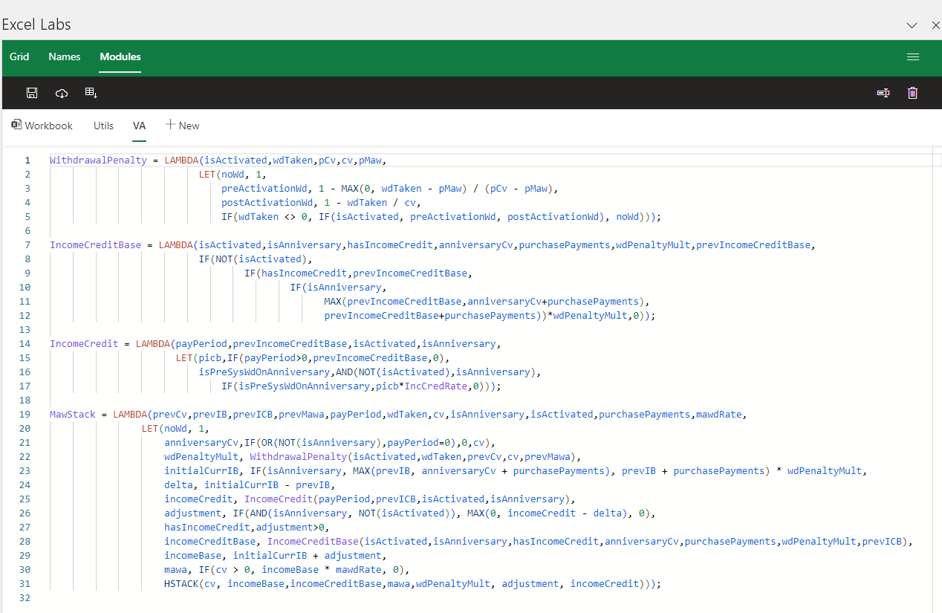
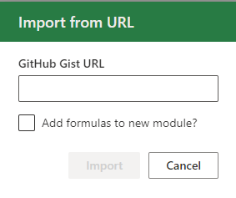
Advance Formula Environment (AFE)
Used for managing reusable libraries
Libraries can be saved into different names spaces
Updates can be easily saved
New formulas imported from spreadsheet into the library
New versions can be downloaded from GitHub.
https://www.microsoft.com/en-us/garage/profiles/excel-labs/

Slide 10

Version Control of Libraries GitHub
We can track changes to the library over time, so we understand changes.
Can easily collaborate with GitHub and fork libraries
https://gist.github.com/RubyTheActuary/cd905e4a97ae6ba88584449b930b57df

Slide 11
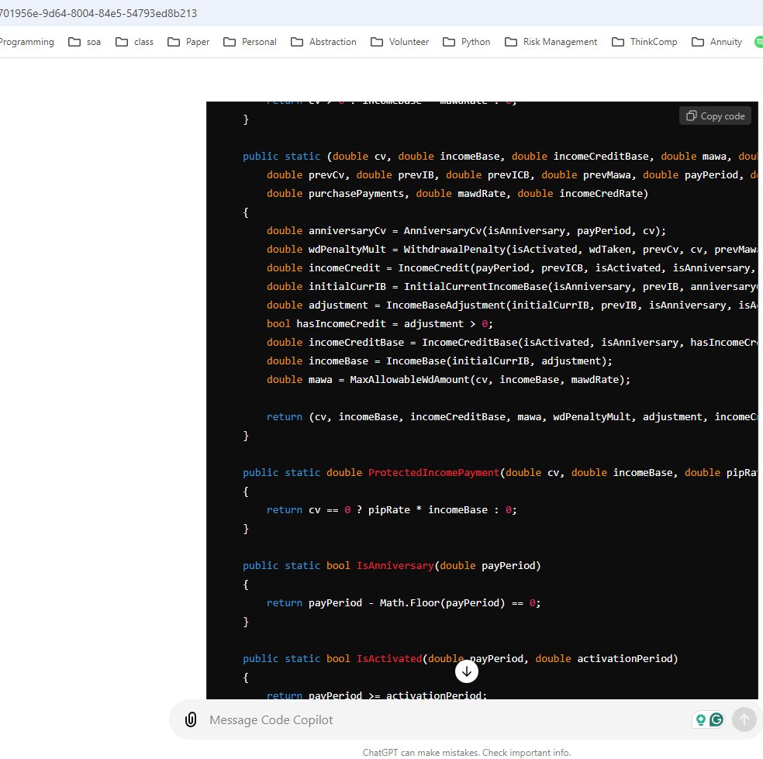
Converting Libraries for other Systems
Typed in to ChatGPT 4.0: Convert Excel Lambdas to C# Followed by Lambda Library Code.
https://chatgpt.com/

Slide 12
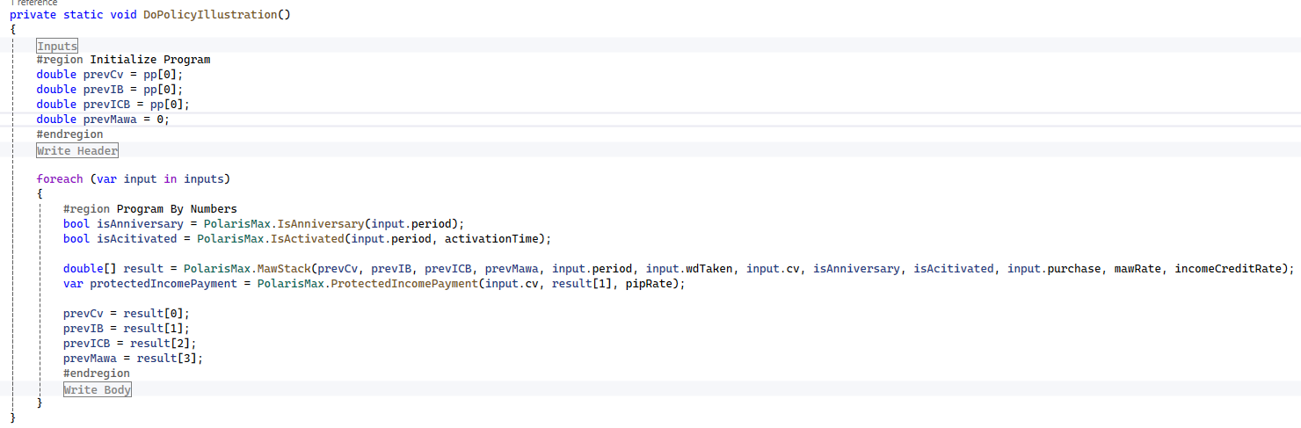
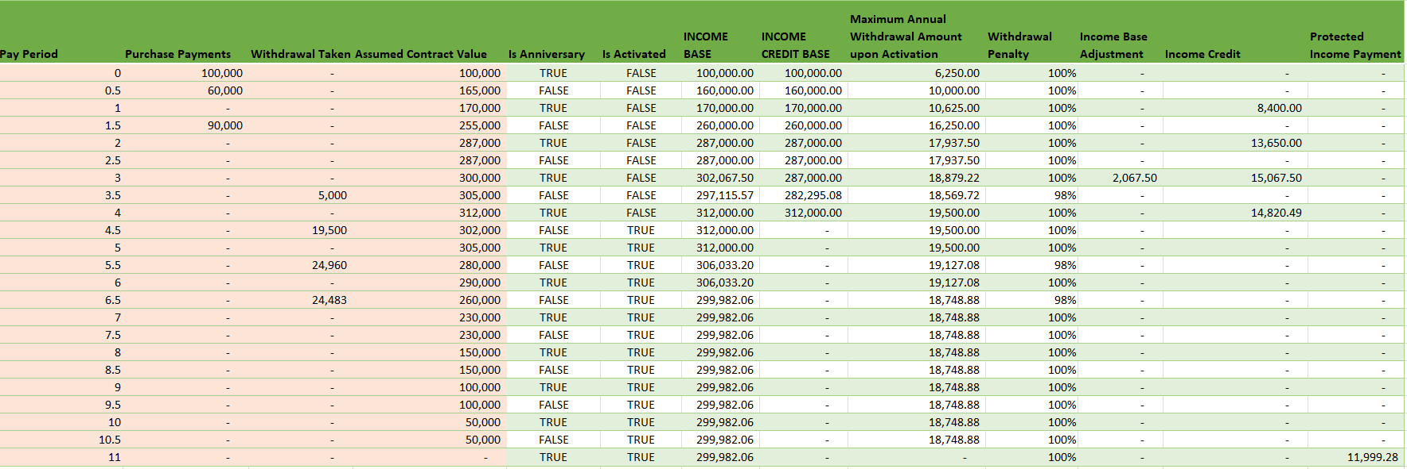
Bang Out Prototype to Match Excel

Slide 13
Why Dynamic Arrays and Lambda Functions?
We separate logic from cell references, which makes logic easier to understand and shareable
We can create a reusable library of components
Creating consistency to cope with non-guaranteed elements, such as annuity rate setting
Creating reusable spreadsheet components that be shared among multiple workbooks, such decrements and dynamic lapse functions
User-friendly and free version control of changes
Libraries can be easily converted to other languages
Increasing turnaround time of new products and updates
Functions can be tested independent and debugged independent of the actual calculation.

Slide 14
The How

Slide 15
Programming Paradigms
Structured Paradigm
Example Languages: VBA, C, Pascal, Fortran, COBOL, Classic Excel
Programming Philosophy: By order of operation much like a task list
Object Oriented Paradigm
Example Languages: C++, C#, VB.NET, Java, SmallTalk
Programming Philosophy: By assigning responsibilities to class, much like a manager delegating to teammates
Functional Paradigm
Example Languages: Haskell, F#, Scala
Programming Philosophy: objects can be thought of as data types, and morphisms (arrows) as functions that transform one type of data into another.

Slide 16

Functional Programming Fundamentals

Slide 17
Functional Programming Concepts
The central concepts are:
Pure functions: Functions that return the same output for the same input and have no side effects.
Immutability: Corresponds to unchangeable data structures after their creation.
Higher-order functions: Functions that take other functions as arguments or return functions.
Function composition: Combining functions to create more complex functions.
Functions as first-class citizens: Functions can be variables just like int and string.
Recursion: Due to immutability, there is no concept of a for or while loop like in procedural languages. To iterate over a structure requires recursion, which is a function that calls itself.

Slide 18
Important Lambda/Functional Helper Functions
MAP : Uses 1 to many arrays to transform to a single result
REDUCE: Compresses a list to a single value. Classic Example: SUM or PRODUCT
SCAN: Is a running total. Can be used to validate a REDUCE function.
HSTACK : Stacks column vectors
VSTACK : Stacks row vectors
DROP : Drops the first item from a vector
TAKE: Takes the first item from a vector
ISOMITTED: True if parameter omitted from lambda.
https://www.thespreadsheetguru.com/dynamic-array-function-list/

Slide 19

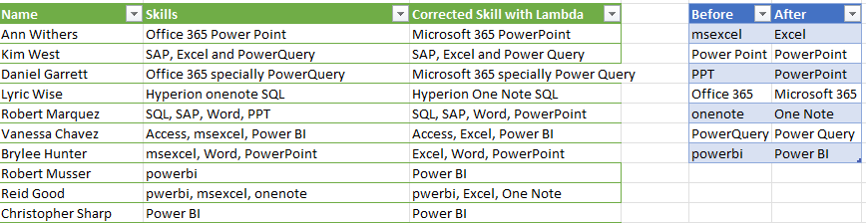
Mega Replace Recursion
Popular personality on building Excel functionality.
She built a recursive equation to fix text strings.
Her explanation is great, but it can be improved.
Mega Replace - https://www.youtube.com/watch?v=L7s6Dni1dG8

Slide 20
Recursion and Impurity
The Video’s Formula
MegaReplace =
LAMBDA(text,beforeText,afterText,
LET(result,SUBSTITUTE(text,beforeText,afterText),
IF(beforeText="",result,MegaReplace(result,
OFFSET(beforeText,1,0),
OFFSET(afterText,1,0)))));
TEXT / INPUT | Before Text | After Text | ANSWER
Office 365 Power Point | msexcel | Excel | Office 365 Power Point
Office 365 Power Point | Power Point | PowerPoint | Office 365 PowerPoint
Office 365 PowerPoint | PPT | PowerPoint | Office 365 PowerPoint
Office 365 PowerPoint | Office 365 | Microsoft 365 | Microsoft 365 PowerPoint
Microsoft 365 PowerPoint | onenote | One Note | Microsoft 365 PowerPoint
Microsoft 365 PowerPoint | PowerQuery | Power Query | Microsoft 365 PowerPoint
Microsoft 365 PowerPoint | powerbi | Power BI | Microsoft 365 PowerPoint
 |  |  | Microsoft 365 PowerPoint

Slide 21
Recursion and Purity
Correcting Video’s Formula
MegaReplaceFix =
LAMBDA(text,beforeArray,afterArray,
LET(bef,TAKE(beforeArray,1),aft,TAKE(afterArray,1),v,SUBSTITUTE(text,bef,aft),
IF(COUNTA(beforeArray)-1=0,
v,
MegaReplaceFix(v,DROP(beforeArray,1),DROP(afterArray,1)))
)
5
2
3
6
7
4
1
TEXT / INPUT | Before Array | After Array | ANSWER
Office 365 Power Point | msexcel | Excel | Office 365 Power Point
Office 365 Power Point | Power Point | PowerPoint | Office 365 PowerPoint
Office 365 PowerPoint | PPT | PowerPoint | Office 365 PowerPoint
Office 365 PowerPoint | Office 365 | Microsoft 365 | Microsoft 365 PowerPoint
Microsoft 365 PowerPoint | onenote | One Note | Microsoft 365 PowerPoint
Microsoft 365 PowerPoint | PowerQuery | Power Query | Microsoft 365 PowerPoint
Microsoft 365 PowerPoint | powerbi | Power BI | Microsoft 365 PowerPoint

Slide 22
Recursion and Impurity
The Video’s Formula
MegaReplace =
LAMBDA(text,beforeText,afterText,
LET(result,SUBSTITUTE(text,beforeText,afterText),
IF(beforeText="",result,MegaReplace(result,
OFFSET(beforeText,1,0),
OFFSET(afterText,1,0)))));
TEXT / INPUT | Before Text | After Text | ANSWER
Office 365 Power Point | msexcel | Excel | Office 365 Power Point
Office 365 Power Point | Power Point | PowerPoint | Office 365 PowerPoint
Office 365 PowerPoint | PPT | PowerPoint | Office 365 PowerPoint
Office 365 PowerPoint | Office 365 | Microsoft 365 | Microsoft 365 PowerPoint
Microsoft 365 PowerPoint | onenote | One Note | Microsoft 365 PowerPoint
Microsoft 365 PowerPoint | PowerQuery | Power Query | Microsoft 365 PowerPoint
Microsoft 365 PowerPoint | powerbi | Power BI | Microsoft 365 PowerPoint
 |  |  | Microsoft 365 PowerPoint

Slide 23
Reduction and Higher-Order Functions
Best Correction for Video Formula
MegaReplace2 = REDUCE(startingTextValue,
MAP(beforeArray,afterArray,
LAMBDA(beforeRow,afterRow,
LAMBDA(t,SUBSTITUTE(t,beforeRow,afterRow))))
,LAMBDA(text1,func,func(text1)));
INPUT | REDUCE Explanation | ANSWER
Office 365 Power Point | LAMBDA(Office 365 Power Point,SUBSTITUTE(Office 365 Power Point,msexcel,Excel)) | Office 365 Power Point
Office 365 Power Point | LAMBDA(Office 365 Power Point,SUBSTITUTE(Office 365 Power Point,Power Point,PowerPoint) | Office 365 PowerPoint
Office 365 PowerPoint | LAMBDA(Office 365 PowerPoint,SUBSTITUTE(Office 365 PowerPoint,PPT,PowerPoint) | Office 365 PowerPoint
Office 365 PowerPoint | LAMBDA(Office 365 PowerPoint,SUBSTITUTE(Office 365 PowerPoint,Office 365,Microsoft 365) | Microsoft 365 PowerPoint
Microsoft 365 PowerPoint | LAMBDA(Microsoft 365 PowerPoint,SUBSTITUTE(Microsoft 365 PowerPoint,onenote,One Note) | Microsoft 365 PowerPoint
Microsoft 365 PowerPoint | LAMBDA(Microsoft 365 PowerPoint,SUBSTITUTE(Microsoft 365 PowerPoint,PowerQuery,Power Query) | Microsoft 365 PowerPoint
Microsoft 365 PowerPoint | LAMBDA(Microsoft 365 PowerPoint,SUBSTITUTE(Microsoft 365 PowerPoint,powerbi,Power BI) | Microsoft 365 PowerPoint
BeforeArray | AfterArray | Result of Map which transformed two strings -> function
msexcel | Excel | LAMBDA(t,SUBSTITUTE(t,msexcel,Excel)))
Power Point | PowerPoint | LAMBDA(t,SUBSTITUTE(t,Power Point,PowerPoint)))
PPT | PowerPoint | LAMBDA(t,SUBSTITUTE(t,PPT,PowerPoint)))
Office 365 | Microsoft 365 | LAMBDA(t,SUBSTITUTE(t,Office 365,Microsoft 365)))
onenote | One Note | LAMBDA(t,SUBSTITUTE(t,onenote,One Note)))
PowerQuery | Power Query | LAMBDA(t,SUBSTITUTE(t,PowerQuery,Power Query)))
powerbi | Power BI | LAMBDA(t,SUBSTITUTE(t,powerbi,Power BI)))

Slide 24
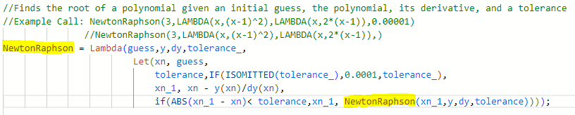
Lambdas and Recursion – Simple Example
Demonstrates:
Pure functions
Recursion
Higher-order functions
Functions as first-class citizens
Function composition

Slide 25
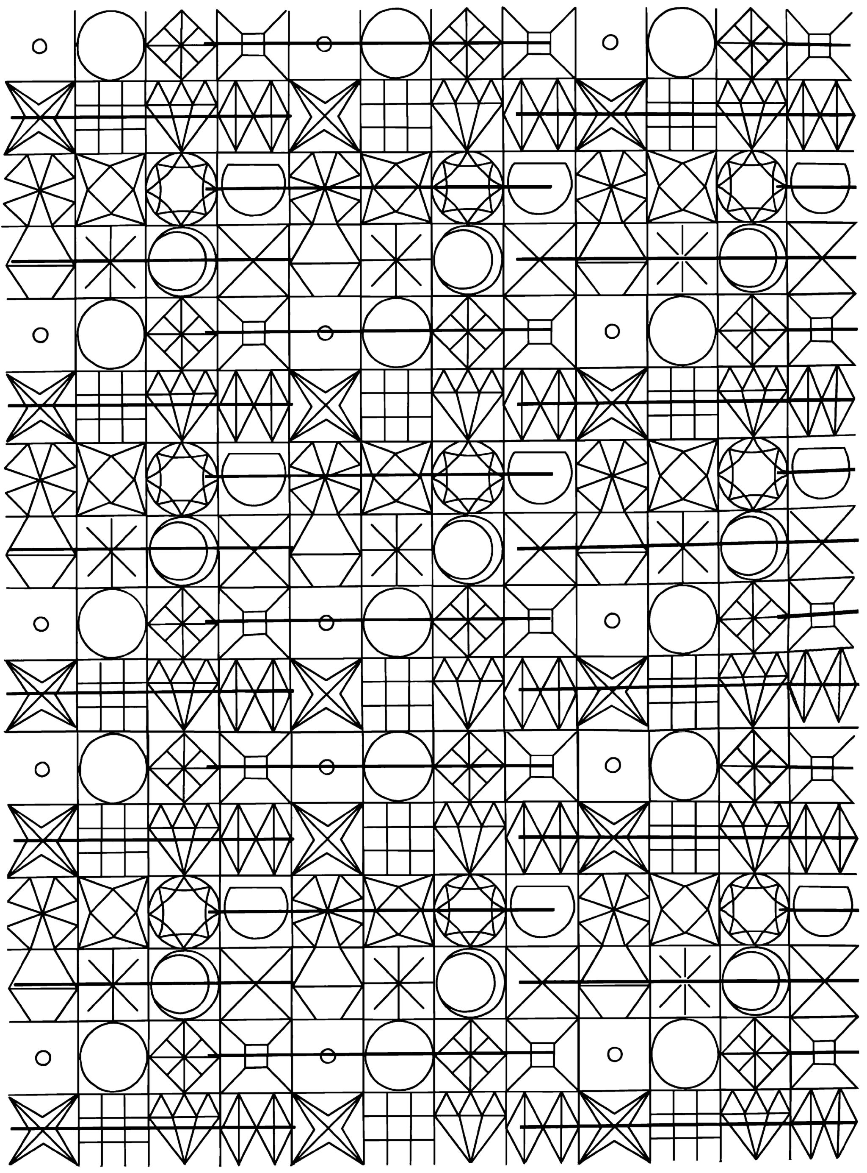
Comparing Dependency Patterns

Slide 26
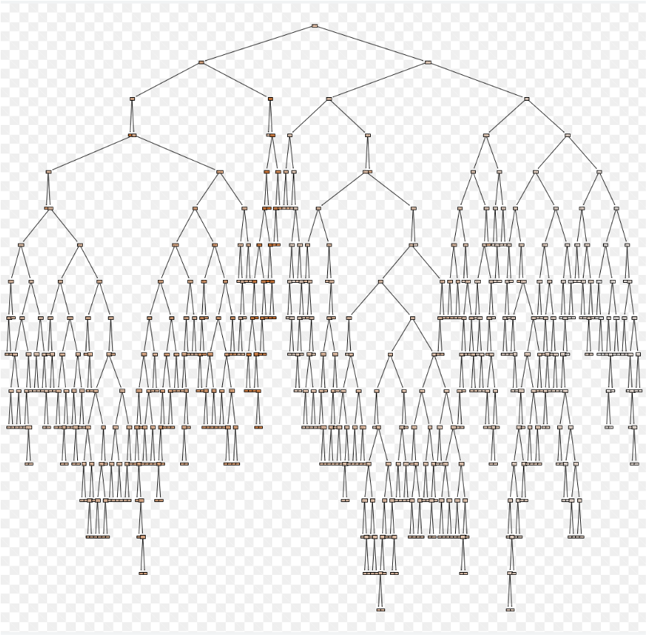
Classic Excel – Calculation Tree
When formulas are made Excel will determine the order of operation.
If the tree has any leaf that points to itself, then a circular reference occurs.
Lastly roll all results to the root node.
Ohio National Life Assurance Corporation
A member of the Constellation Insurance Inc. family of companies

Slide 27
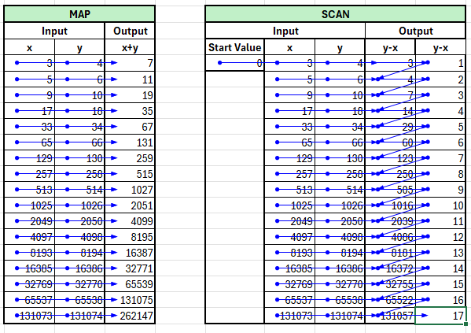
Classic Excel Pattern Dependencies
A map is a higher-order function that applies a given function to each element of a collection returning the results in a collection of the same type.
A scan is a higher-order function that takes a starting value and applies a function which is used to accumulate successive values. The intermediate values of this accumulation are returned as a collection of the same type.
SCAN documentation: https://support.microsoft.com/en-us/office/scan-function-d58dfd11-9969-4439-b2dc-e7062724de29
MAP =B5+C5
SCAN =G5-F5; =H5-G5; =G6-J5; =H6-I6

Slide 28
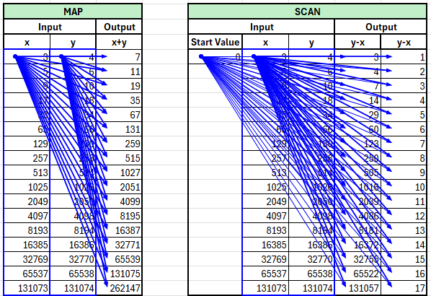
Dynamic Array Excel Pattern Dependencies
Dynamic Arrays in Excel 365 let you work with a range of values in a single cell.
Instead of entering a formula that outputs to a single cell, you can use a formula that "spills" results into neighboring cells automatically.
There are significant concepts to consider:
Spilling: The formula automatically fills cells with multiple values.
Dynamic: The output adjusts if the source data or formula changes.
Functions: Lambda functions can be applied consistently over the entire array.
Dynamic Arrays can be seen as super cells.
Notice how the dependency always refers to the starting cells of the input and spills into the output dynamic array.
=MAP($C$5:$C$21,D5:D21,LAMBDA(x,y,x+y))
=SCAN($G$5,$H$5#,LAMBDA(acc,curr,curr-acc))
Dynamic Array Function Documentation: https://www.thespreadsheetguru.com/dynamic-array-function-list/

Slide 29
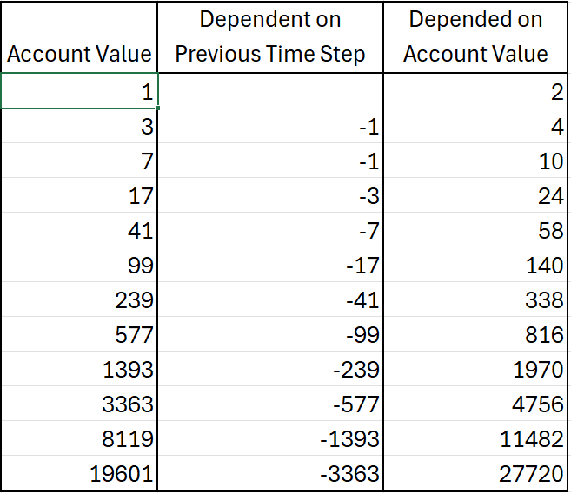
Understanding Complicated Dependencies in Classic Excel Illustrations
Notice the Functional Triangle that causes the circular reference when only using dynamic arrays and lambda helper functions.
This is a very common pattern with annuities due to the interaction between benefit bases and account values.
This pattern will force you to create a lambda library by consolidating logic between columns.

Slide 30
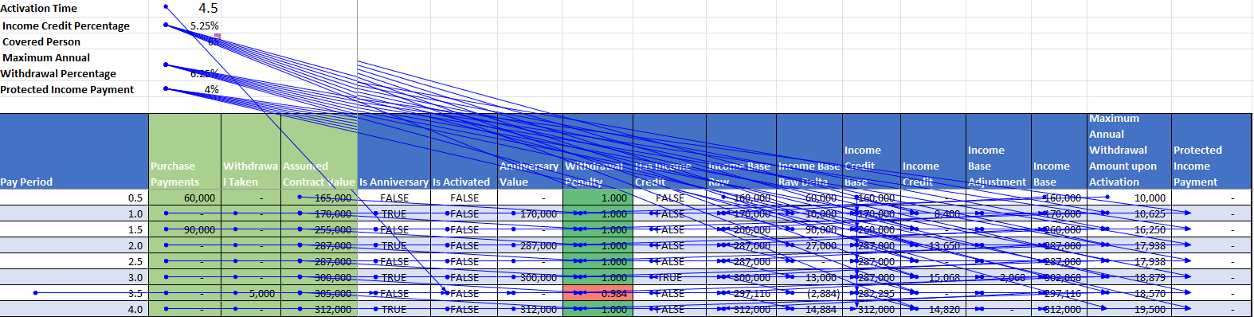
A Complicated VA Prospectus Classical Dependencies
Very complicated inner relationship among the dependencies even in this simplified example.
Even though complicated, there are no circular references in this classic Excel implementation.
Follows the SCAN and Death V dependency patterns.

Slide 31
Programming By Numbers

Slide 32
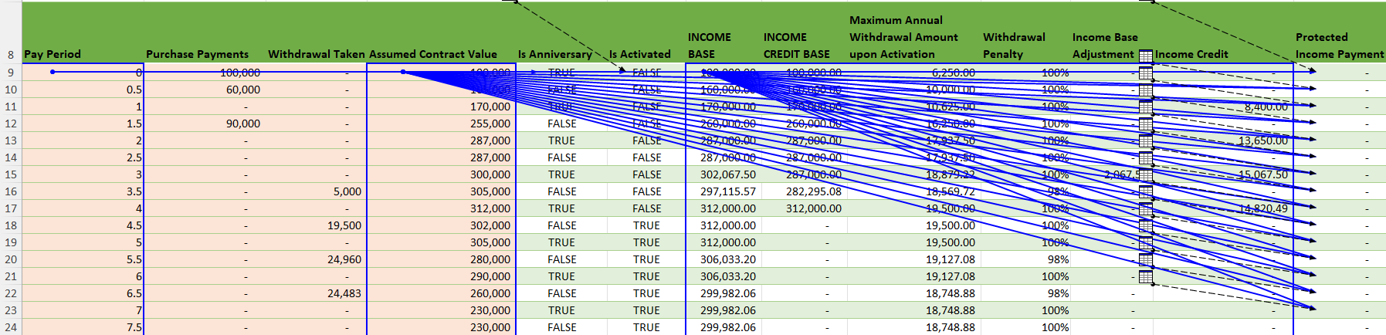
A Complicated VA Prospectus Dynamic Arrays Dependencies
See how the Illustration with dynamic arrays follow the pattern after logic has been extracted into the library.
Bad News: Requires a little more programming chops.

Slide 33

Issue with Divergence from Functional Programming.

Slide 34
More Functional Fun
List
Collection of items of the same type
Tuple
Collection of items of different types.
Used to create an object with different properties.
For example: Policyholder properties are issue age, gender, premium amount.
The tuple named policyholder would contain and integer, string, double.
The policyholder extract would be a list of policyholder tuples.
Problem: Excel combines these concepts.
It may sound a good simplification, but it complicates greatly!

Slide 35
Lambda Helper Limitation / No Tuples
MegaReplace2 = REDUCE(startingTextValue,
MAP(beforeArray,afterArray,
LAMBDA(before,after,
LAMBDA(t,SUBSTITUTE(t,before,after))))
,LAMBDA(text1,func,func(text1)));
SCAN / REDUCE functions
Scans an array by applying a LAMBDA to each value and returns an array that has each intermediate value.
Reduce returns the last value of the Scan.
Syntax
=SCAN ([initial_value], array, lambda(accumulator, value, body))
Example= SCAN(1, A1:C2, LAMBDA(a,b,a*b))
Example=REDUCE(1, A1:C2, LAMBDA(a,b,a*b))
The SCAN or Reduce function syntax has the following arguments and parameters:
[initial_value] Sets the starting value for the accumulator.
array An array to be scanned.
lambda A LAMBDA that is called to reduce the array. The LAMBDA takes three parameters:
accumulator The value totaled up and returned as the final result.
value The current value from the array.
body The calculation applied to each element in the array.
Problems with Scan, Reduce, Map:
Excel treats each cell independently.
The initial_value expects an individual value instead of a list of values.
Problem this forces me to roll my own, which increase the need for programming chops.

Slide 36
Conclusion
The bad
It will require actuaries to increase their programming chops, but extremely doable.
Purely functional programming is a very different mindset than the imperative mindset of VBA.
The good
By relying only on lambda functions and dynamic arrays, we can greatly speed up the ability to communicate complicated logic to other interested parties.
We can easily read, translate, and version control business logic of the Excel code.
Reads far more mathematical and easier to relate to actuarial textbooks.
Given we are more accustomed to functional programming, I think it will give us 10X speed up for creating illustrations due to reusability of lambda libraries.
The tradeoff is worth it because it will increase the problem-solving capabilities of everyone involved.
Learning different programming paradigms is always worth the effort.
The new paradigm forces you into better programming habits
https://github.com/RubyTheActuary/Excel-Lambda-Examples

